Slide 1


Slide 2
HOTEL PRICING
Econometric Methods

Slide 3
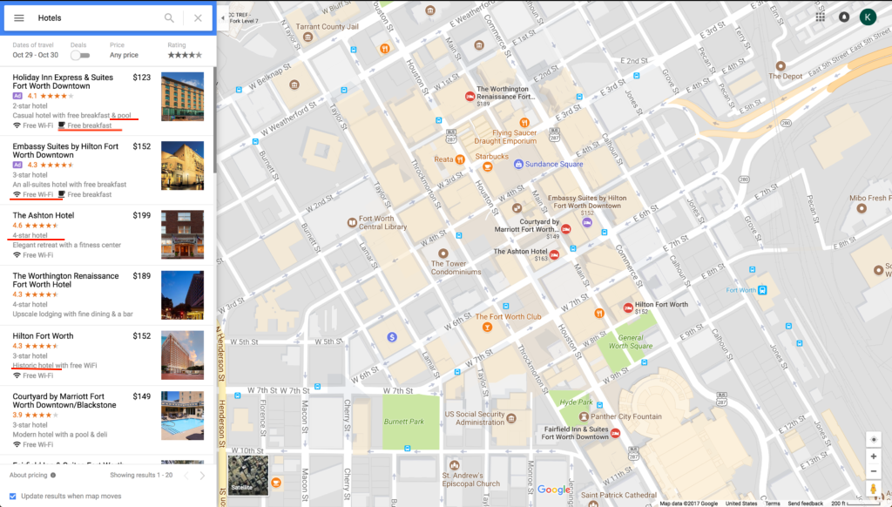
Tourist destination
Free breakfast
Free Wi-Fi
4 star hotel ****
Swimming Pool

Slide 4
Why hotel pricing
Tourism is one of the biggest industries for a city/country
Complex phenomenon: costs vary across hotels, markets, time of booking, location, flexibility etc.
Choices: preferences vs constraints
Do we really pay for what we avail?
Can help in shaping investment and pricing strategies for hoteliers lined up in expectations of the market
We, as customers, get an understanding of what we are paying for
Notes:
Hedonic pricing: Goods are valued for their utility-bearing attributes or characteristics

Slide 5
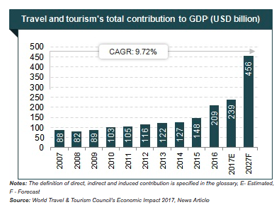
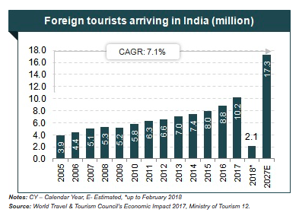
Notes:
Compound Annual Growth Rate

Slide 6
Literature review
Idea of product as a set of attributes first proposed by Lancaster in 1966
Carvell, Herrin (1990) first to apply the hedonic approach in the hotel room market
Research on hotel pricing carried out in different places throughout the world
For example, Thrane (2006) studies room rates for a one- night stay in the Norwegian capital of Oslo, while Chen and Rothschild (2010) makes a similar approach to the case of Taipei, Taiwan

Slide 7
Characterising Data
The data was collected from www.hotels.in as on 18/12/16, 21/12/16, 24/12/16, 25/12/16, 28/12/16, 31/12/16, 04/01/17, 08/01/17
42 Indian cities
Y: Room rent
Xi: Population, city rank, metro city, tourist destination, weekend/weekday, New Year’s, star rating, distance from airport, free WiFi, free breakfast, hotel capacity, swimming pool.
Cities42_Data

Slide 8
Range of data
Room rent: INR 299 - 322500
Hotel Capacity: 11 - 600
Airport distance: 0.2 - 124
Date of booking: 18th December 2016 - 8th January 2016
Cities across India... Mumbai, Delhi, Chennai, Goa, Thrissur, Kolkata, Ahmedabad…..

Slide 9
Introducing Variables
Hedonic Pricing- do we pay for what we get?
City characteristics: Population, city rank, metro city, tourist destination
Time characteristics: Weekend, New year eve
Hotel characteristics: Star rating, distance from airport, free WiFi, free breakfast, hotel capacity, swimming pool

Slide 10
Model 1(a): Regression of hotel characteristics on room rent, weekend
In this, we look at regressing hotel characteristics on room rent on IsWeekend.
Y: room rent
X1: star rating
X2: distance from airport
X3: free WiFi
X4: free breakfast
X5: hotel capacity
X6: swimming pool
X7: IsWeekend

Slide 11
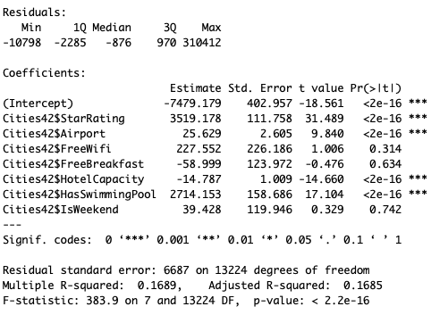
Model 1(a)-Done on full data-Interpretation
Statistically Insignificant Variables : Free Wifi, Free Breakfast and IsWeekend.
Rest of the variables lie deep enough in the interval of significance to discard the null hypothesis
The F statistic, which indicates the overall significance of all the variables combined comes out to be 383.9, with a p value low enough to reject the null hypothesis
Hence, it is irrelevant to the Room Rent if it is a weekday or the weekend

Slide 12
Model 1(b): Regression of hotel characteristics on room rent, New Year
In this, we look at regressing hotel characteristics on room rent on IsNewYearEve.
Y: room rent
X1: star rating
X2: distance from airport
X3: free WiFi
X4: free breakfast
X5: hotel capacity
X6: swimming pool
X7: IsNewYearEve

Slide 13
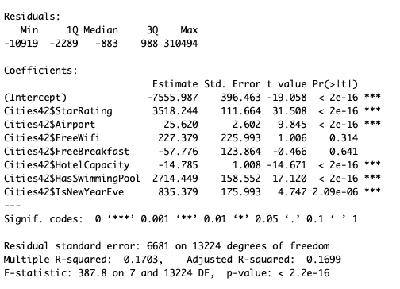
Model 1(b)- Done on full data Interpretation
Statistically Insignificant Variables : Free Wifi and Free Breakfast.
Rest of the variables lie deep enough in the interval of significance to discard the null hypothesis
The F statistic, which indicates the overall significance of all the variables combined comes out to be 387.8, with a p value low enough to reject the null hypothesis

Slide 14
Model 2: City-wise regression analysis
We take 4 cities:
 | IsMetroCity | IsTouristDestination
Delhi | 1 | 1
Chennai | 1 | 0
Bangalore | 0 | 0
Goa | 0 | 1

Slide 15
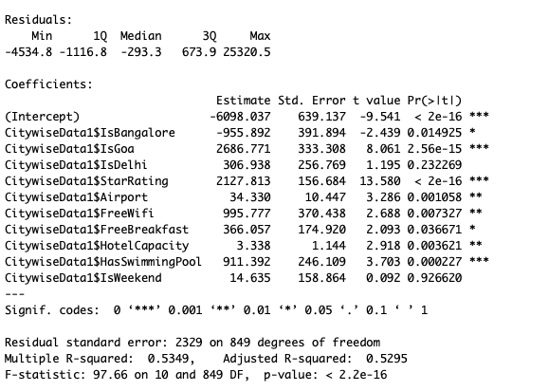
City wise Analysis
R square increases considerably, as we see that room rent depends a lot on the city being a tourist destination or a work city etc
Variables earlier insignificant now become significant, maybe because each of them affect each city differently, which was earlier not observable
Weekend is still an insignificant factor
The F statistic, which indicates the overall significance of all the variables combined comes out to be 97.66, with a p value low enough to reject the null hypothesis

Slide 16
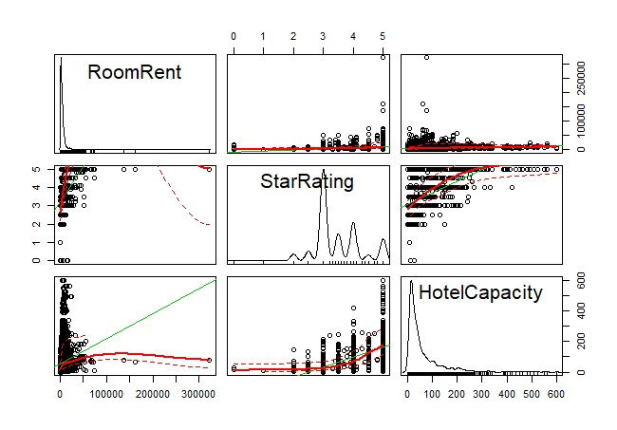

Slide 17
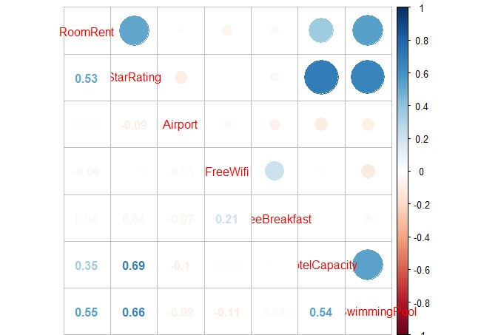
Correlation matrix

Slide 18
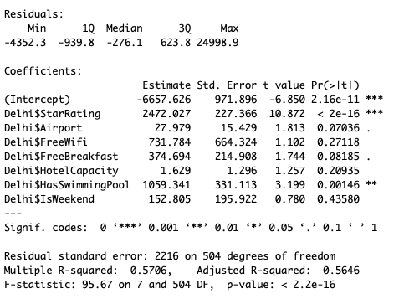
Delhi
Delhi is a metro city as well as a tourist destination
Significant Variables (at 5% significance)- StarRating, HasSwimmingPool
Adjusted R Square = 0.56
F-statistic comes out to be 95.67 with p value sufficiently low to reject null hypothesis.

Slide 19
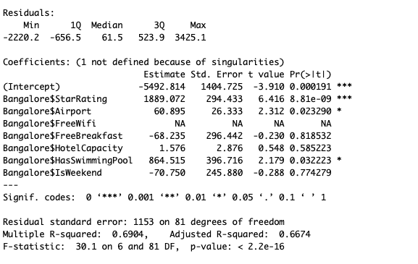
Bangalore
Bangalore is neither a tourist destination nor a metro city
Significant variables at 5% significance: StarRating, Airport and HasSwimmingPool
Adjusted R Square = 0.67
F-statistic comes out to be 95.67 with p value sufficiently low to reject null hypothesis.

Slide 20
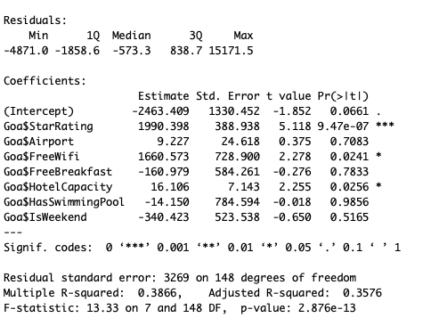
Goa
Goa is a tourist destination but not a metro city
Significant variables at 5% significance: StarRating, FreeWiFi and HotelCapacity
Adjusted R Square = 0.36
F-statistic comes out to be 95.67 with p value sufficiently low to reject null hypothesis.

Slide 21
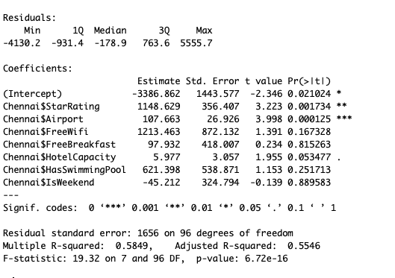
Chennai
Chennai is a metro city but not a tourist destination
Significant variables at 5% significance- StarRating, Airport and FreeWiFi
Adjusted R Square = 0.55
F-statistic comes out to be 95.67 with p value sufficiently low to reject null hypothesis.

Slide 22
Variable | Expected Effect | Effect in this study
IsTouristDestination | + | +
IsWeekend | + | IS
IsNewYearEve | + | +
StarRating | + | +
Airport | - | +
FreeWiFi | + | IS
FreeBreakfast | + | IS
HotelCapacity | - | +
HasSwimmingPool | + | +
IS: Insignificant
+: Positively significant
-: Negatively significant

Slide 23
Insignificant Variables
IsWeekend: One can argue that surge pricing is more effective and justified in festive season, whereas increasing weekend price is an evident bias. Moreover, weekend surge pricing would result in loss in business as corporates work on weekdays, while trips are planned on vacations, not weekend per se. More of a concept abroad
FreeWiFi: No more a hurdle, thanks to Jio
FreeBreakfast: Added charge more beneficial, as that provides flexibility

Slide 24
Significant Variables
Airport: Hotels preferred in city (usually airport outside city)
Hotel Capacity: Less means luxury vs more means capacity; chain of hotels -> brand value

Slide 25
Problems with the model
Misspecification
Four cities might not be able to capture the characteristics of the defined city in general
Refundability is a big factor, that has not been taken into account
Multicollinearity- Dealing with multiple variables
Heteroskedasticity- Cross sectional data
Misspecification- Relevant/irrelevant variables

Slide 26
Correlation and MC analysis
As expected and as we can see, StarRating and HotelCapacity, SwimmingPool are highly correlated
If they are highly linearly correlated, it can cause error in regression estimates
We can look at VIF (Variance Inflation Factors) in order to decide if we need to discard any variable or not

Slide 27
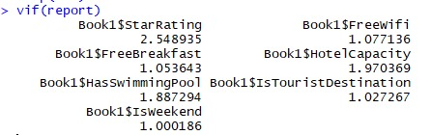
VIF
VIF of Star rating is relatively higher as expected, but that isn’t a big problem to our model, so we don’t discard it
In general, we don’t discard any variable

Slide 28
Heteroskedasticity?
There is a possibility of heteroskedasticity as we are dealing with cross sectional data
For example, for high room rent, variance in hotel capacity or distance from airport is possibly very high
For different cities, variance characteristics are different
In such a case, the assumption that variance is uniform throughout might be a bad one

Slide 29
Conclusion
Hotel pricing depends on more than just what we pay (for what we consume)
It is a dynamic, but not a flexible concept, meaning there are factors that affect pricing and have to be accounted for
In order to define a structure, a primary thing is the city that one is looking at
These results are not likely to be universal
Complex phenomenon- not an overstatement

Slide 30
Thank You

Slide 31
Presented to you by
Arundhati Dixit
Ayush Srivastava
Tanmay Soni

